Slide 1
CASE STUDY EDA
BY:SANKET GARG

Slide 2
Introduction
This assignment aims to give you an idea of applying EDA in a real business scenario. In this assignment, apart from applying the techniques that you have learnt in the EDA module, you will also develop a basic understanding of risk analytics in banking and financial services and understand how data is used to minimize the risk of losing money while lending to customers.

Slide 3
Business Understanding
The loan providing companies find it hard to give loans to the people due to their insufficient or non-existent credit history. Because of that, some consumers use it to their advantage by becoming a defaulter. Suppose you work for a consumer finance company which specializes in lending various types of loans to urban customers. You have to use EDA to analyze the patterns present in the data. This will ensure that the applicants capable of repaying the loan are not rejected.
When the company receives a loan application, the company has to decide for loan approval based on the applicant’s profile. Two types of risks are associated with the bank’s decision:
If the applicant is likely to repay the loan, then not approving the loan results in a loss of business to the company
If the applicant is not likely to repay the loan, i.e. he/she is likely to default, then approving the loan may lead to a financial loss for the company.

Slide 4
The data given, contains the information about the loan application at the time of applying for the loan. It contains two types of scenarios:
The client with payment difficulties: he/she had late payment more than X days on at least one of the first Y instalments of the loan in our sample,
All other cases: All other cases when the payment is paid on time.

Slide 5
Business Decisions
When a client applies for a loan, there are four types of decisions that could be taken by the client/company):
Approved: The Company has approved loan Application
Cancelled: The client cancelled the application sometime during approval. Either the client changed her/his mind about the loan or in some cases due to a higher risk of the client, he received worse pricing which he did not want.
Refused: The company had rejected the loan (because the client does not meet their requirements etc.).
Unused offer: Loan has been cancelled by the client but at different stages of the process.
In this case study, you will use EDA to understand how consumer attributes and loan attributes influence the tendency to default.

Slide 6
Business Objectives
This case study aims to identify patterns which indicate if a client has difficulty paying their instalments which may be used for taking actions such as denying the loan, reducing the amount of loan, lending (to risky applicants) at a higher interest rate, etc. This will ensure that the consumers capable of repaying the loan are not rejected. Identification of such applicants using EDA is the aim of this case study.
In other words, the company wants to understand the driving factors (or driver variables) behind loan default, i.e. the variables which are strong indicators of default. The company can utilise this knowledge for its portfolio and risk assessment.
To develop your understanding of the domain, you are advised to independently research a little about risk analytics - understanding the types of variables and their significance should be enough.

Slide 7
Data Understanding
The dataset has 3 files as explained below:
1. 'application_data.csv' contains all the information of the client at the time of application. The data is about whether a client has payment difficulties.
2. 'previous_application.csv' contains information about the client’s previous loan data. It contains the data on whether the previous application had been Approved, Cancelled, Refused or Unused offer.
3. 'columns_description.csv' is data dictionary which describes the meaning of the variables.

Slide 8
ANALYSING OUTLIERS:

Slide 9
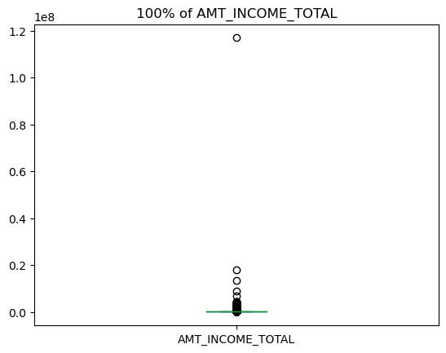
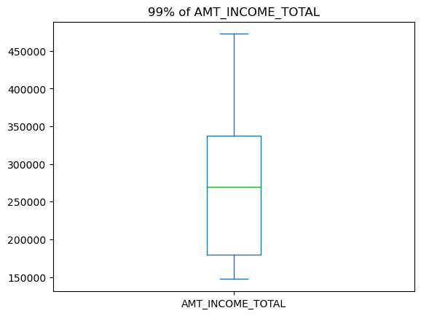
Analysis of outliers of AMT_INCOME_TOTAL
Here we can see that only top1% of Amt_total_income are outliers all the other that is 99% lies inside the whiskers

Slide 10
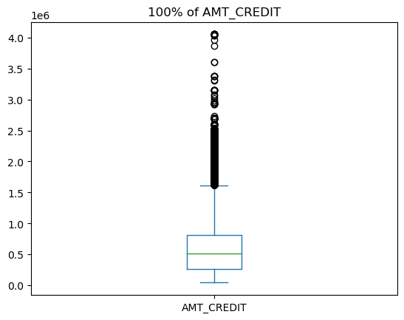
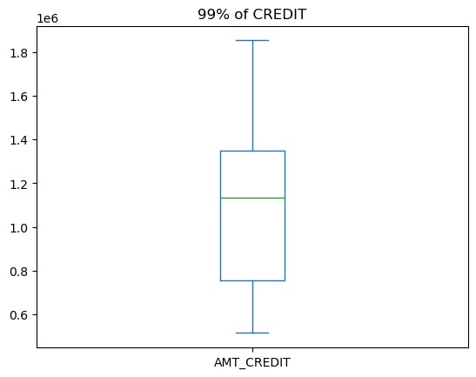
Analysis of outliers of AMT_CREDIT
Here also the trend we see is same as the previous one where the top 1% lies outside the whiskers and the other 99% lies inside it

Slide 11
Analyzing data count

Slide 12
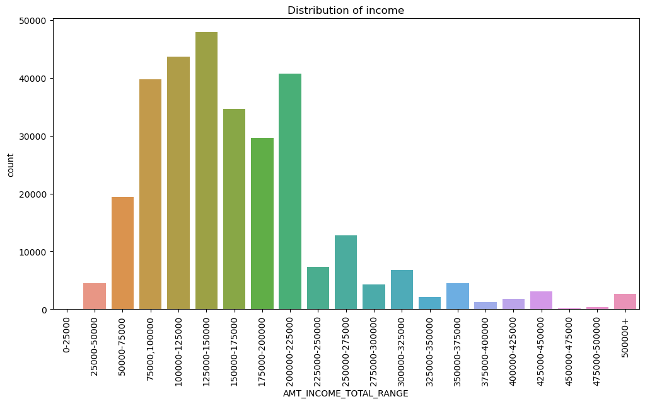
Distribution of income
Most number of people lies in the range of 125000-150000 and the least lies in the range of 450000-475000

Slide 13
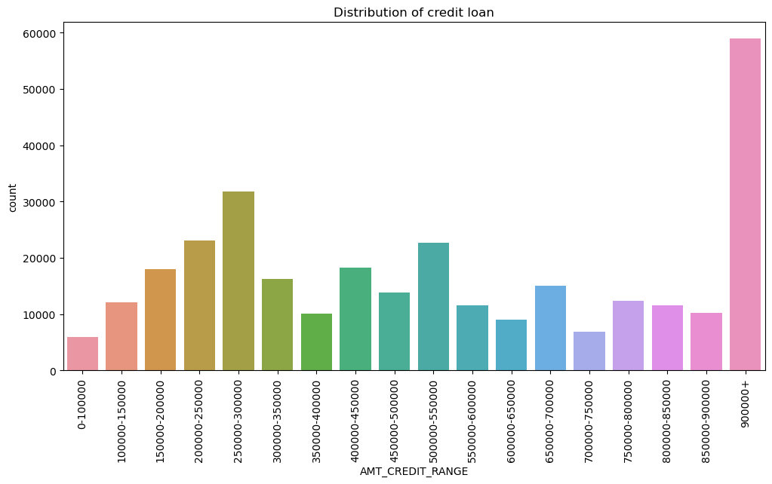
Distribution of credit loan
Here it can be seen the most number of people lies in 900000+ range and the least lies in 0-100000 range here a variation can be seen in the trend

Slide 14
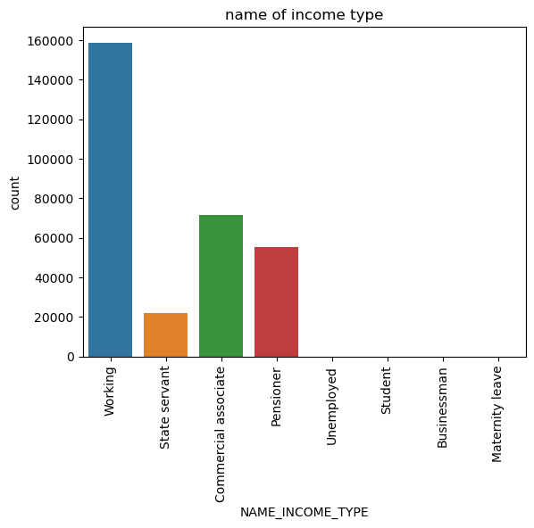
Distribution of people on occupation basis
This graph illustrates that the working class has most number of people

Slide 15
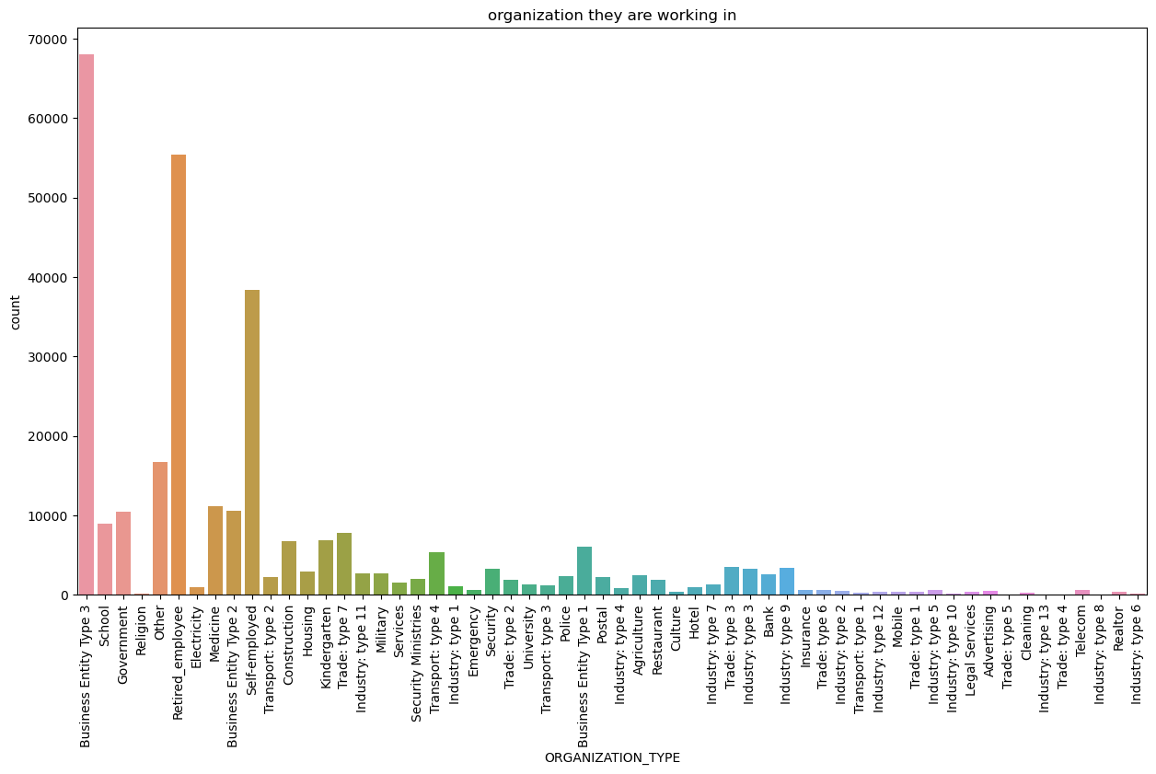
Distribution of people acc. To their working place
Most number of people woks as a businessman and Retired employee and Self employed lies at second and third place respectively

Slide 16
Analyzing data on the basis of gender

Slide 17
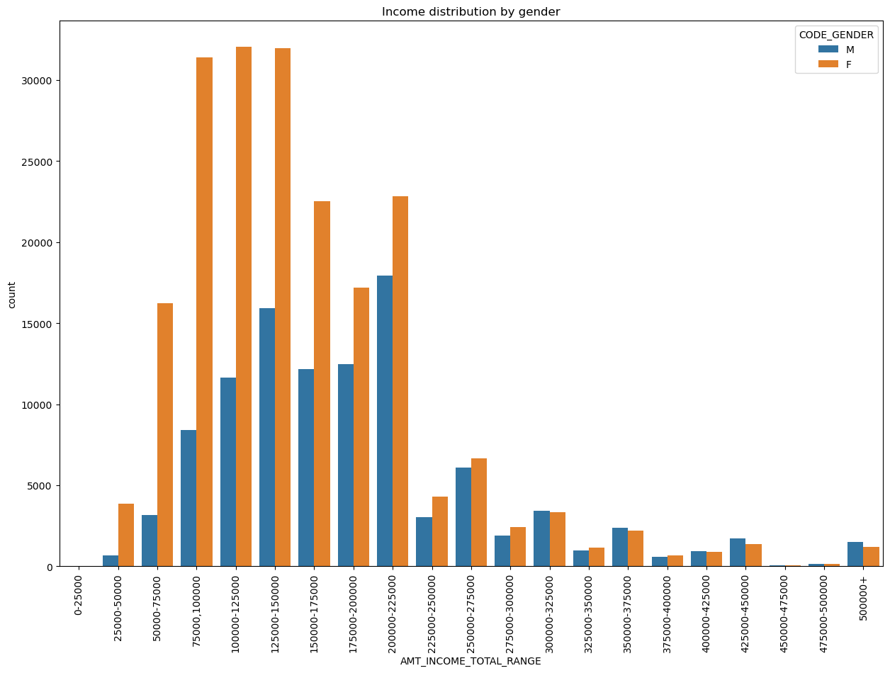
Income data by gender
Here it can be seen that most females lies in the range of 50000-225000
In case of males that is not True

Slide 18
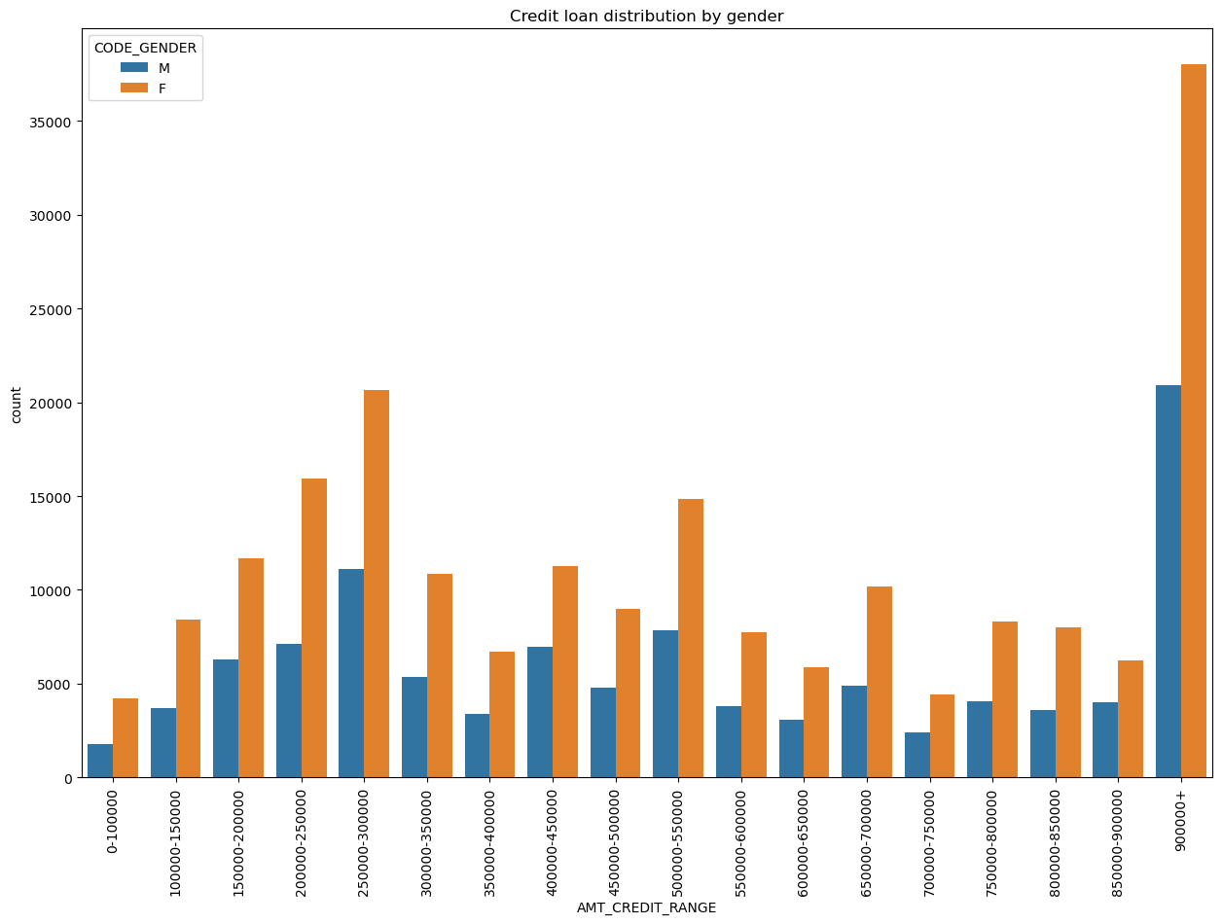
Credit loan data by gender
From the graph it can be discern that the most credit loans taken by females are in the range of 900000+, males also takes the credit loan in that range the most

Slide 19
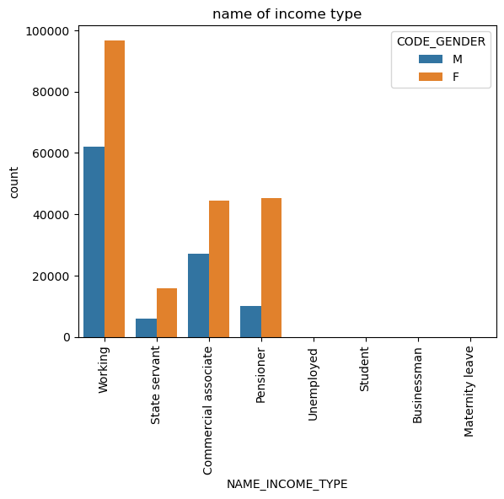
Occupation distribution on the basis of gender
In the data-frame females are more of the working type occupation the count is same for Pensioner and Commercial associate
Males are most working type and then at second place stands commercial associate

Slide 20
Analyzing on the basis of payment status

Slide 21
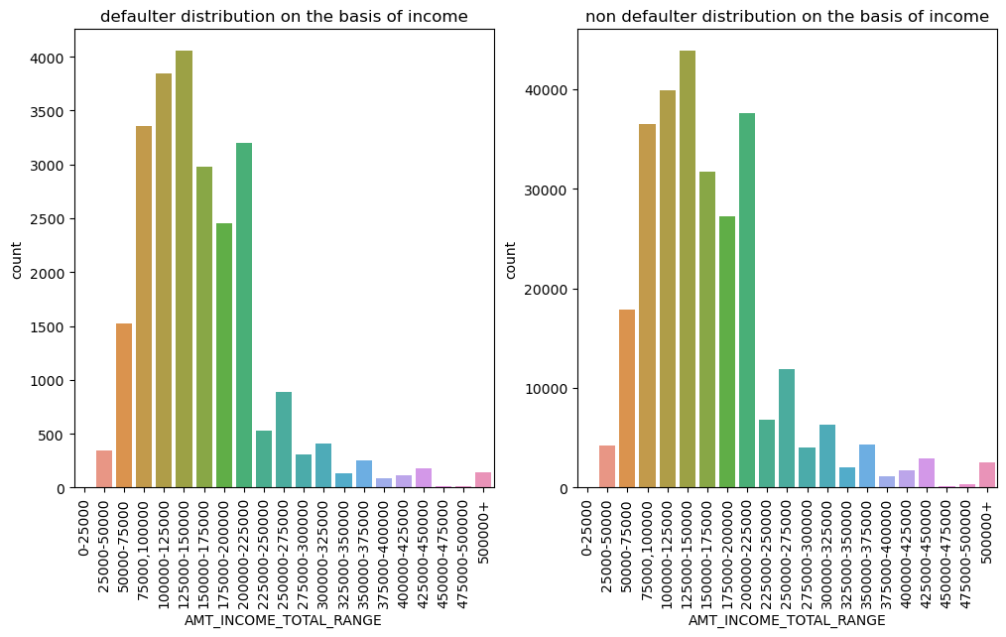
Status of payment on income basis
Both defaulters and non defaulters approximately follow the same trend, The only difference is of the count of both the graphs

Slide 22
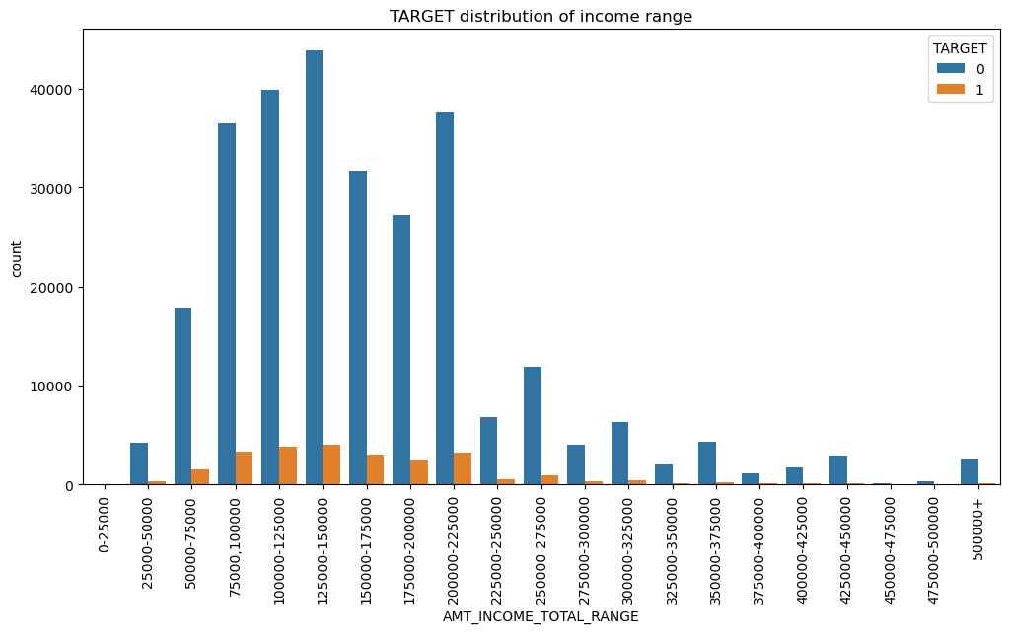
If we add both the graphs in the same graphs we can see that the trend followed them by is same

Slide 23
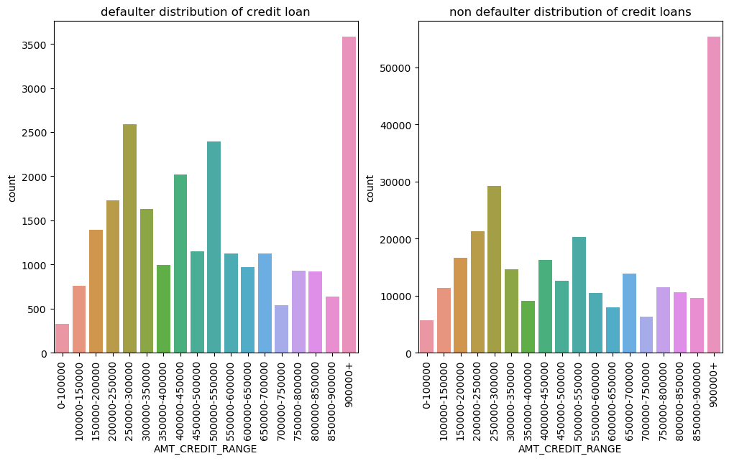
Status of payment on credit loan basis
Same as the income type they both follow the same trend

Slide 24
Finding the correlation

Slide 25
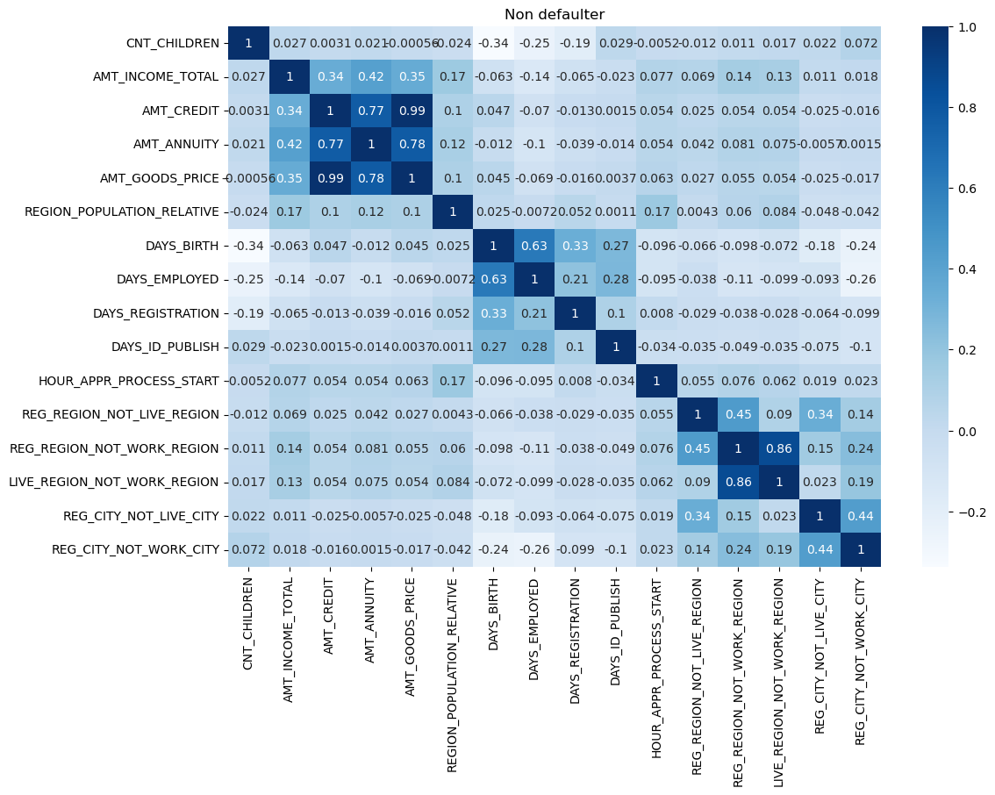
Correlation for non-defaulters
Amt_INCOME_TOTAL is correlated to AMT_ANNUNITY
AMT_CREDIT is highly correlated to AMT_GOODS_PRICE which is true as credit is given on goods price
AMT_ANNUNITY is directly proportional to AMT_CREDIT (higher the loan higher the EMI)
AMT_ANNUNITY is directly proportional to AMT_GOODS_PRICE (higher the goods price higher the EMI)

Slide 26
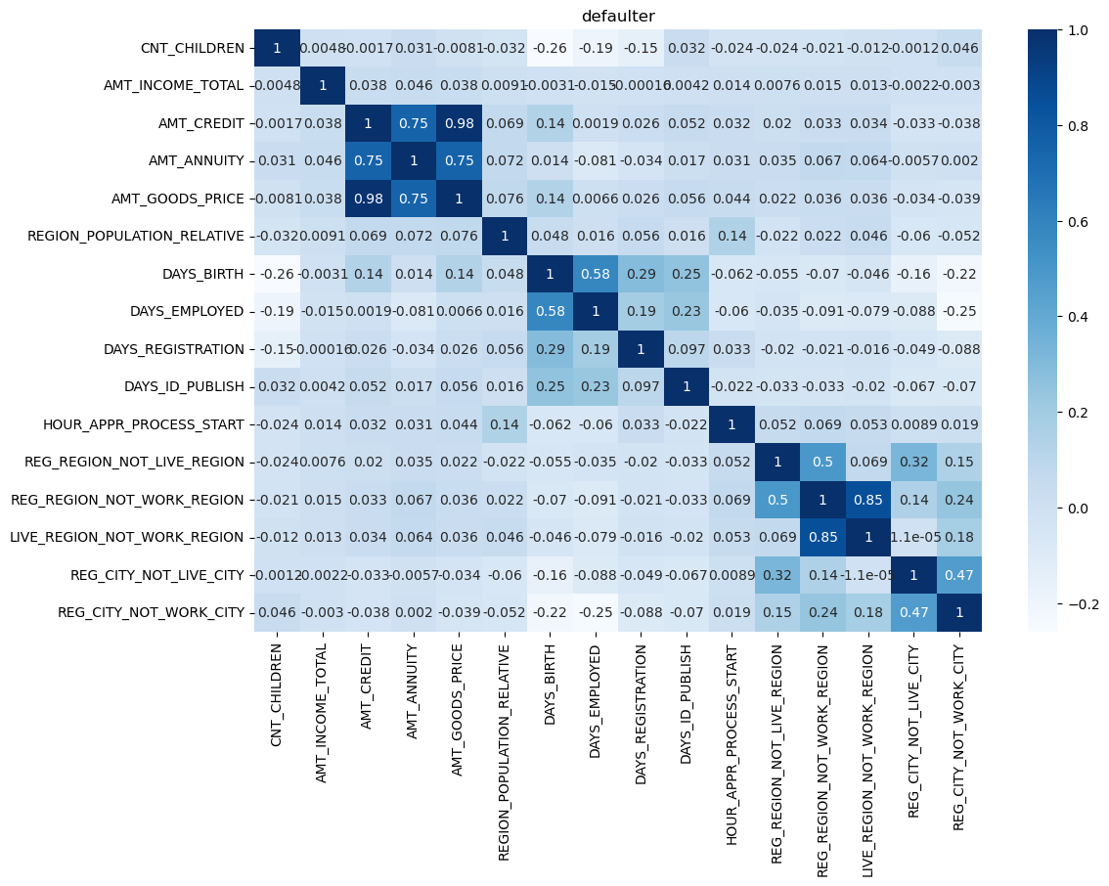
Correlation for defaulters
The trends are same as the non defaulters but there are some slight changes in values

Slide 27
Outliers for defaulters and non defaulters

Slide 28
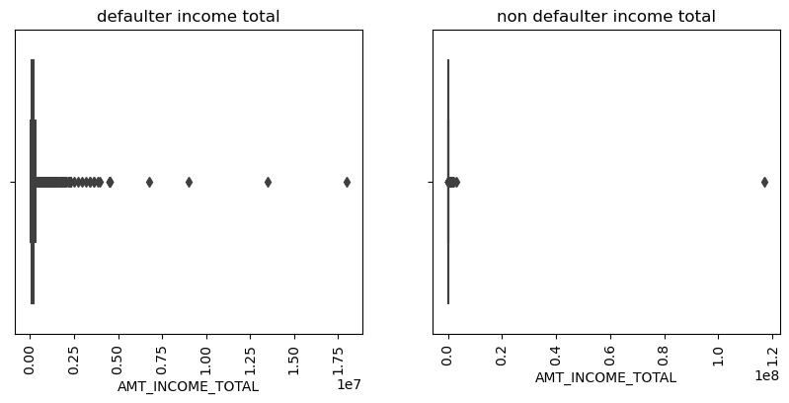
Side by side comparison of income type outlier
We can see that there are more outliers for defaulters and for non-defaulters approx all the outliers exist in a bunch

Slide 29
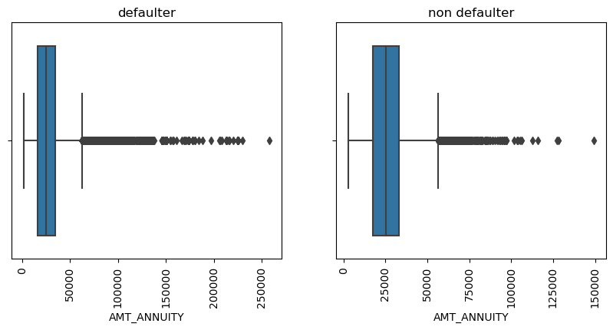
AMT_ANNUNITY side by side comparison
There are quite a few outliers in the defaulter and non defaulters graphs but there is a kind of continuity in defaulter graph outliers

Slide 30
Bivariate analysis

Slide 31
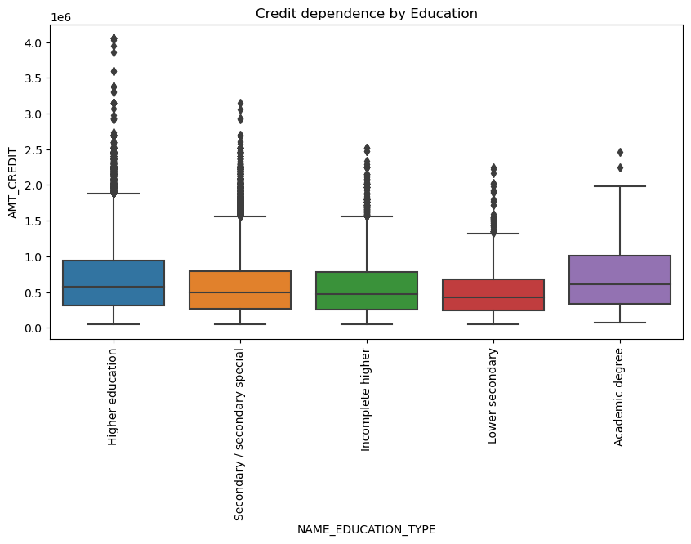
Credit dependence by education
Higher education has high AMT_CREDIT and has more outliers too the median value is also higher as compared to the others.
Lower secondary has lowest AMT_CREDIT
Academic degree has the least amount of outliers but its median lies with the same range as higher education

Slide 32
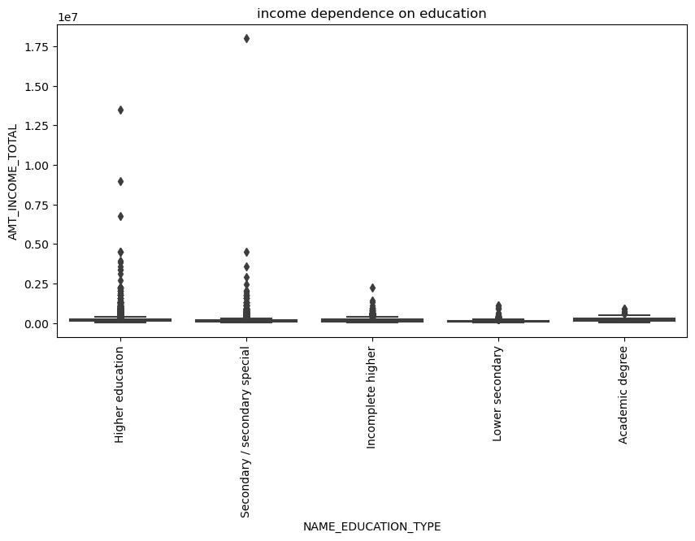
Income dependence on education
Higher education has more outliers and hence more income
Lower secondary has less income type

Slide 33
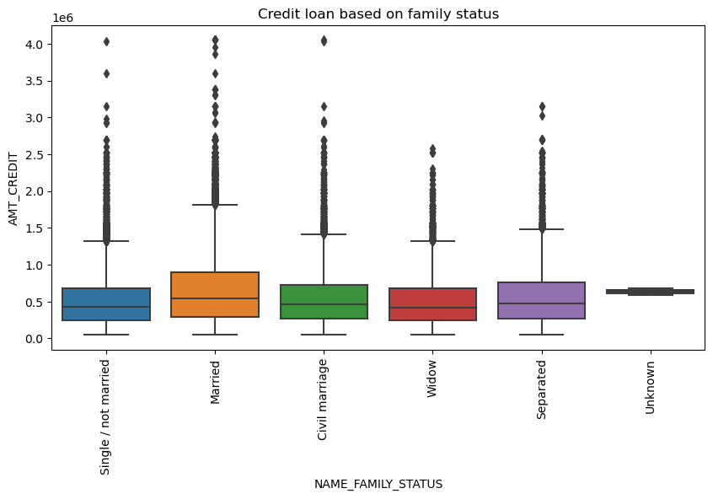
Credit loan based on family status
Here we can see that married has taken highest number of loans and single and widow has taken the lowest amount of loans

Slide 34
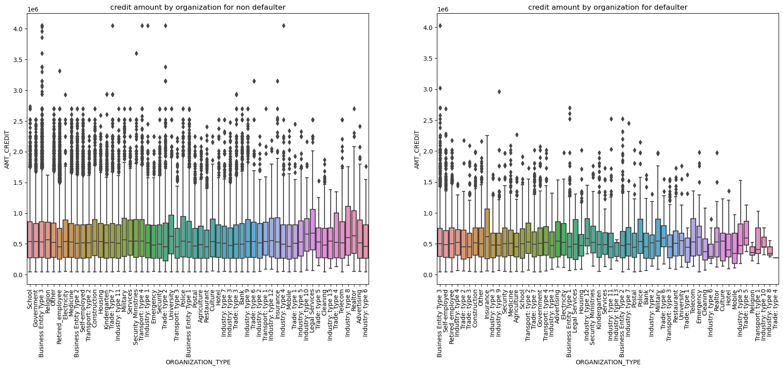
Credit amount by organization
For non defaulter the most loan was taken by businessman
For defaulter the most is taken by insurance

Slide 35
Analysis of loan acceptance

Slide 36
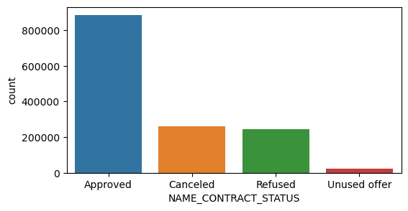
Total numbers of loans acceptance status
The number of the approved loans are the highest

Slide 37
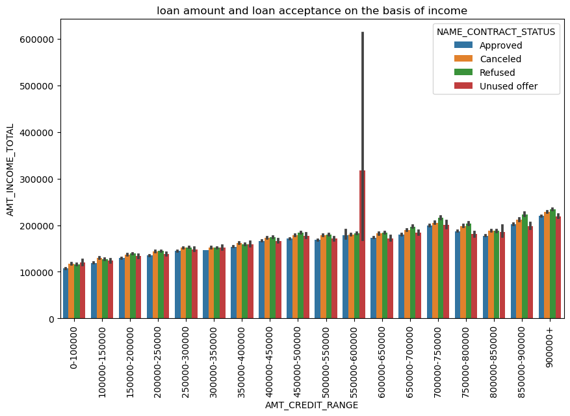
Loan amount and loan acceptance on the basis of income
The most number of unused offer is of credit range of 550000-600000 with income of about 600000
The most number of approved loans is of credit range 900000

Slide 38
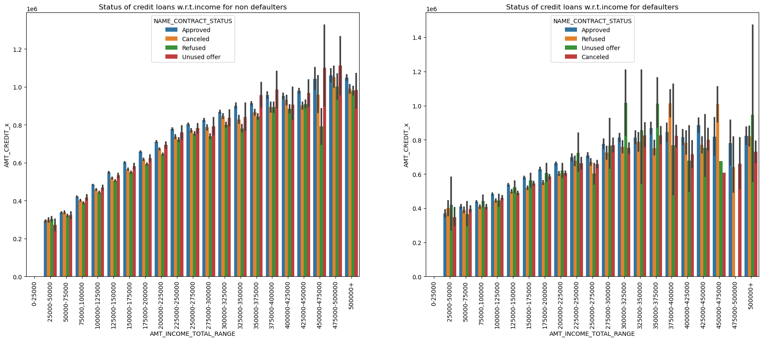
Loan accept Status of credit loans
For non defaulters the most number of approved loans are in range 475000-500000
For defaulters the most number of approved loans are in range 425000-450000

Slide 39
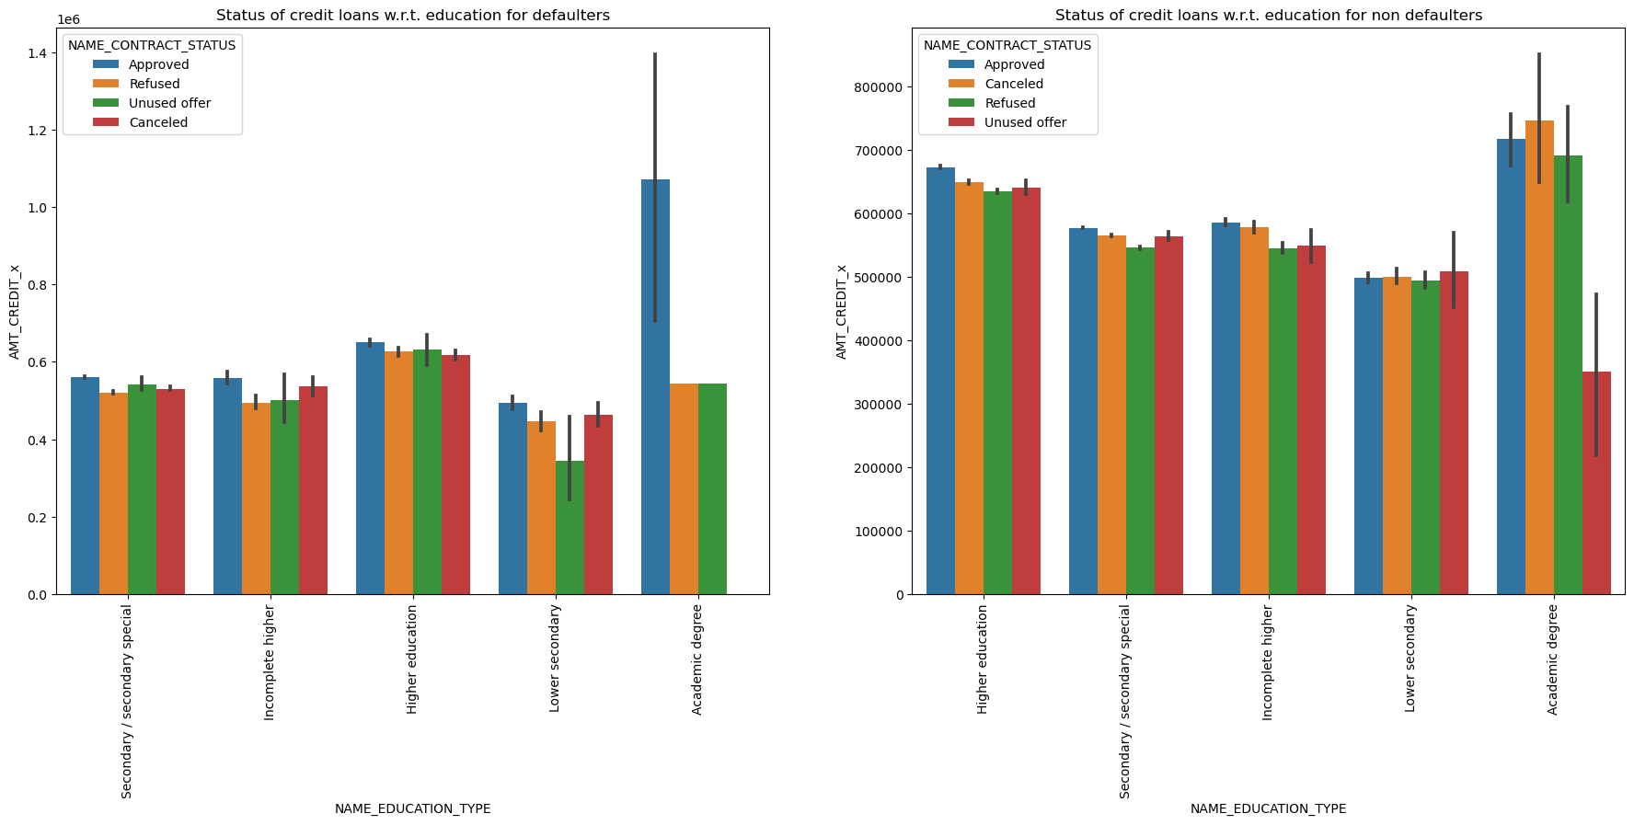
Loan accept status on the basis of education
In the defaulter and non-defaulter graph the most approved loan is of academic degree
The amount of loan approved in higher education is greater for non defaulter than defaulter

Slide 40
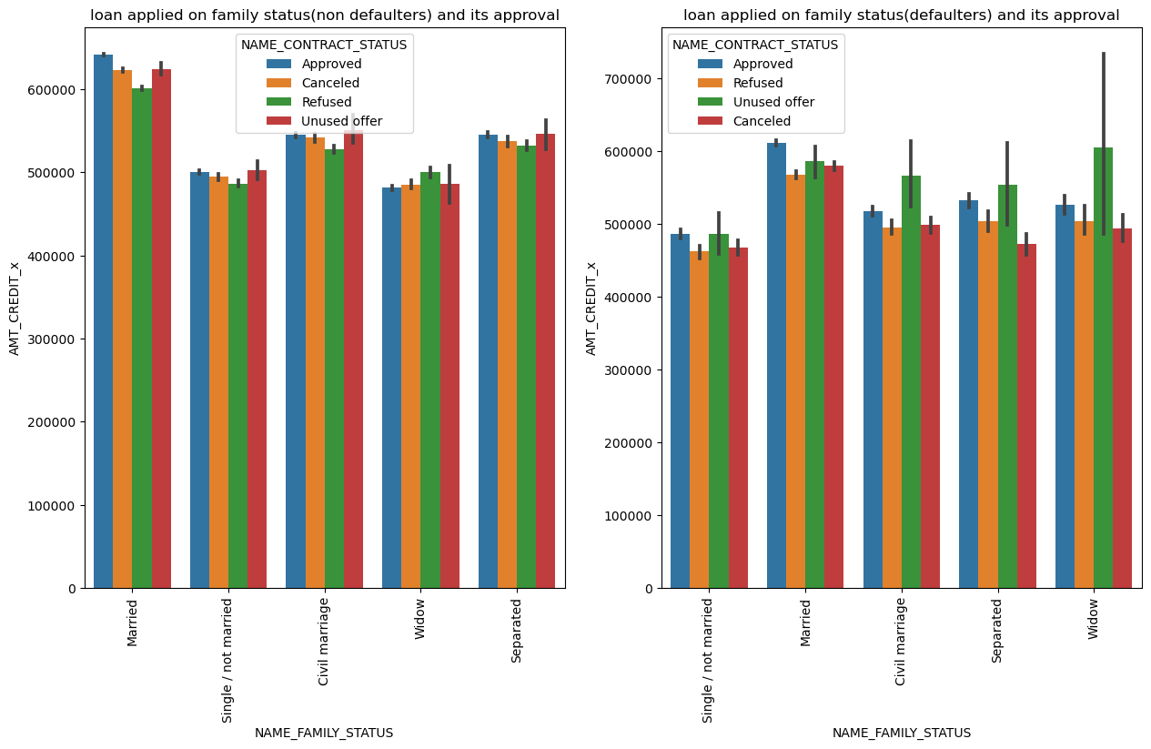
Loan acceptance on family status basis
Married persons loans are most approved
The most unused offer is of married for non defaulters and of widow for non defaulters

Slide 41
Conclusion
We have now completed the analysis and have find the various parameters on the basis of which a loan can be approve or not.
We have also found the correlation between the different variables and values.
We have found the total count of different-different data values
Performed univariate analysis, bivariate analysis on the dataframe.
Cleaned the dataset according to our requirement

Slide 42
THANK YOU

